Slide 1
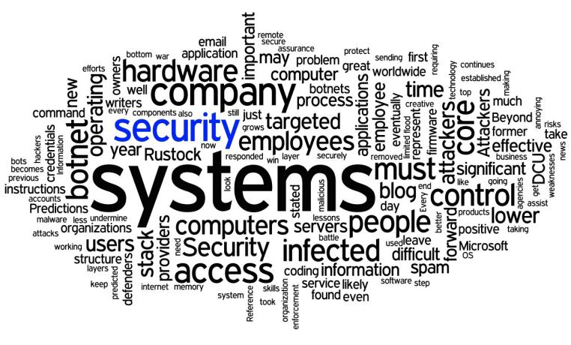
Network Infrastructure Security and Connectivity
School of Computer Science and IT JAIN (DEEMED-TO-BE UNIVERSITY) Department of Bachelor of Computer Applications
Module 4

Slide 2

Topics to be covered :
Understanding Infrastructure Security
Device Based Security
Media-Based Security
Monitoring and Diagnosing
Monitoring Network- Firewall
Intrusion Detection System
Intrusion Prevention system
OS and Network Hardening
Application Hardening
Physical and Network Security- Policies, Standards and Guidelines.

Slide 3
Network Infrastructure
Network infrastructure is the hardware and software resources of an entire network that enable network connectivity, communication, operations and management of an enterprise network.
It provides the communication path and services between users, processes, applications, services and external networks in the internet.
A typical network infrastructure includes:
Networking Hardware:
Routers
Switches
Cables

Slide 4
Networking Software:
Network operations and management
Operating systems
Firewall
Network security applications
Network Services:
T-1 Line
DSL
Satellite
Wireless protocols
IP addressing

Slide 5
NETWORK SECURITY
Network Security is the process of taking physical and software preventative measures to protect the underlying networking infrastructure from :
Unauthorized access
Misuse
Malfunction
Modification
Destruction
Thereby creating a secure platform for computers, users and programs to perform their permitted critical functions within a secure environment.

Slide 6
Types of Network Security
To protect the secret information users on the net only. No other person should see or access it.
To protect the information from unwanted editing, accidently or intentionally by unauthorized users.
To protect the information from loss and make it to be delivered to its destination properly.
To protect the message from unwanted delay in the transmission lines/route in order to deliver it to required destination in time, in case of urgency.

Slide 7
Device based Security
Access control
Antivirus and antimalware software
Application security
Behavioral analytics
Data loss prevention
Firewalls
Intrusion prevention systems
Web security
VPN

Slide 8
ROUTERS
Computer network infrastructure consists of different types of components such as:
Firewalls
Routers
Switches
Modems
Servers
Every device that is connected to a network has security concerns.
Each of the components in network needs to be adequately secured.

Slide 9
Routers are highly intelligent devices that connect multiple network types and determine the best path for sending data.
Routers regulate traffic between similar networks.
The advantage of using a router over a bridge is that routers can determine the best path that data can take to get to its destination.
Routers are normally used to connect one LAN to another.

Slide 10
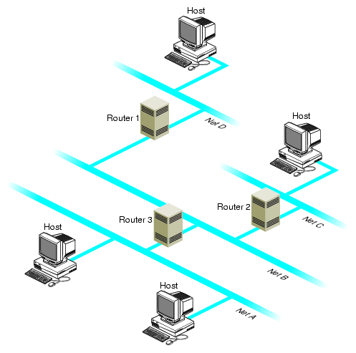

Slide 11
Properties of Router
A router, like a switch forwards packets based on address.
A router uses the IP address to forward packets. This allows the network to go across different protocols.
Routers forward packets based on software while a switch (Layer 3 for example) forwards using hardware called ASIC (Application Specific Integrated Circuits)
Routers support different WAN technologies but switches do not.

Slide 12
Securing a Router
Change the default admin password
Turn on HTTPS access to the router interface, if available, and always log out when done.
Choose a complex Wi-Fi password and a strong security protocol
Keep your router's firmware up to date
Disable WPS (Wi-Fi Protected Setup)
http://192.168.0.1

Slide 13
Securing Router
1. Encrypt your Wi-Fi network.
2. Change important default settings.
3. Turn off remote access-related features.
4. Update the router's firmware.
5. Log out properly.

Slide 14
Switch
Allow different nodes of a network to communicate directly with each other.
Allow several users to send information over a network at the same time without slowing each other down.
A vital difference between a hub and a switch is that all the nodes connected to a hub share the bandwidth among themselves, while a device connected to a switch port has the full bandwidth all to itself.

Slide 15
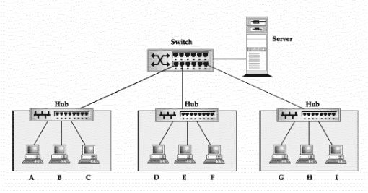
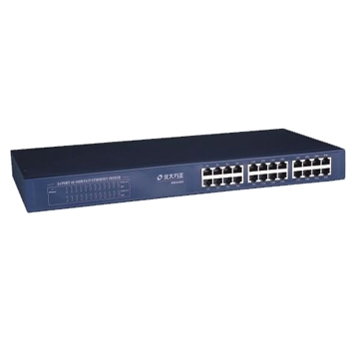

Slide 16
Properties of switch
A switch when compared to bridge has multiple ports.
Switches can perform error checking before forwarding data.
Switches are very efficient by not forwarding packets that error-ed out or forwarding good packets selectively to correct devices only.
Switches can support both layer 2 (based on MAC Address) and layer 3 (Based on IP address) depending on the type of switch.
Usually large networks use switches instead of hubs to connect computers within the same subnet.

Slide 17
Securing Switch
Create an "enable secret" password.
Set timeouts for sessions and configure privilege levels.
Configure a banner to state that unauthorized access is prohibited.
Set a strong password for SSH and use it instead of telnet.
Utilize the switch's port mirroring capability for IDS access.
Utilize static VLAN configuration.

Slide 18
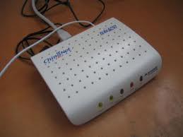
MODEM
A modem is a computer peripheral that
allows us to connect
and communicate with other computers
via
telephone lines.
In other words, Modem (Modulator-Demodulator)
is a communication device
that converts binary signal into analog signals (Modulation)
for transmission over the telephone lines and converts
these analog signals back into binary form ( Demodulation)
at the receiving end.

Slide 19
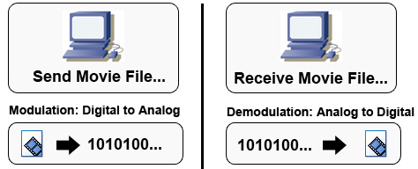
WORKING OF MODEM

Slide 20
TWO BASIC PHYSICAL TYPES OF MODEM:
1. INTERNAL MODEM:
2. EXTERNAL MODEM:
Modems that are fixed within the computers. The advantage of an internal modem is the lack of extra wires required for installation. Internal modems get their power from the computer's power
supply.
Modems connected externally to the computer. External modems require a power source and extra wires to connect to the computer. The advantage of external modems is that they feature lights on the front so you can monitor the connection status.

Slide 21
Securing Modem
Change Default Administrator ( Passwords and User names)
Assign Static IP Addresses to Devices
Enable MAC Address Filtering
Enable Wireless Security
Turn on (Compatible) WPA / WEP Encryption
Change the Default SSID (Service Set Identifier)
Enable Firewall on Modem Router as well as Computer
Turn off Modems during extended periods of Non-Use

Slide 22
Hardening
Hardening is usually the process of securing a system by reducing its surface of vulnerability, which is larger when a system performs more functions;
In principle a single-function system is more secure than a multipurpose one.
Reducing available ways of attack typically includes changing default passwords, the removal of unnecessary software, unnecessary usernames or logins, and the disabling or removal of unnecessary services.

Slide 23
Computer Hardening
Hardening refers to providing various means of protection in a computer system. Protection is provided in various layers and is often referred to as defense in depth
Protecting in layers means to protect at the host level, the application level, the operating system level, the user level, the physical level and all the sublevels in between. Each level requires a unique method of security.
Hardening’s goal is to eliminate as many risks and threats to a computer system as necessary

Slide 24
Hardening activities for a computer system can include
Keeping security patches and hot fixes updated
Monitoring security bulletins that are applicable to a system’s operating system and applications
Installing a firewall
Closing certain ports such as server ports
Not allowing file sharing among programs
Installing virus and spyware protection, including an anti-adware tool so that malicious software cannot gain access to the computer on which it is installed

Slide 25
Keeping a backup, such as a hard drive, of the computer system
Disabling cookies
Creating strong passwords
Never opening emails or attachments from unknown senders
Removing unnecessary programs and user accounts from the computer
Using encryption where possible
Hardening security policies, such as local policies relating to how often a password should be changed and how long and in what format a password must be in

Slide 26
OS Hardening
Hardening of the OS is the act of configuring an OS securely, updating it, creating rules and policies to help govern the system in a secure manner, and removing unnecessary applications and services.
This is done to minimize a computer OS's exposure to threats and to mitigate possible risk.
Server hardening, which is also referred to as operating system hardening, is the process of making the server stronger and more resistant to security issues.

Slide 27
OS Security
OS security may be approached in many ways, including adherence to the following:
Performing regular OS patch updates
Installing updated antivirus engines and software
Scrutinizing all incoming and outgoing network traffic through a firewall
Creating secure accounts with required privileges only (i.e., user Management)

Slide 28
Process of OS Hardening
Removing unnecessary programs
Use of service packs
Patches management
Policies related to password management
File and directory access -Encryption
Disable the guest account and features.
Install anti-virus software and updates, and firewalls.
Restrict permissions to files, services, registry entries and end-points.

Slide 29
Benefits of OS Hardening
Saves money in the long run
Eliminates access points
Improves performance
Reduces holes in security

Slide 30
Network Hardening
Everything in the form of hardware or software, needs a touch of system or network hardening to be truly secure:
From disabling non-required services
To renaming access accounts and
Resetting passwords.
Any corporate network without a properly configured IDS or firewall is an insecure corporate network
You should take steps to protect your network from intruders by configuring the other security features of the network’s servers and routers

Slide 31
Network Hardening
Network security is always an ongoing process because the threats to it keep changing.
Although security threats are continually evolving, administrators can use some techniques to harden the base network structure to help ease the ever shifting security landscape.
These hardening techniques establish a good security foundation that can be further built upon making the network that much harder to crack

Slide 32
Techniques
Use Secure protocols whenever possible
SSH – Create Encrypted comm. Session between devices. (Instead of Telnet)
SNMP V3 – Supports Encryption (More secure than the previous two versions)
SFTP- It encrypts whole process – SSH-FTP (Instead of FTP)
TLS – Cryptographic protocol – Encrypt online communication (Instead of SSL)
HTTPS – Comm. b/w Web server and browser (Instead of HTTP)

Slide 33
Contd..
Anti-Malware Software :
Network based anti-malware : The application is installed within the local network and served to the individual clients that require it.
It is easily administered, but harder to tune for the individual host.
But the network administrator can ensure that it remains up to date.

Slide 34
Security Measures
Implementing Switch Security Measures:
Password –Hashing or Encrypted
MAC address Filtering
DHCP Snooping Enabled
DAI Enabled- Dynamic ARP Inspection
Implementing Router Security Measures:
ACL – In bound and Out bound

Slide 35
Others
Using a firewall
Disabling unnecessary services
Install patches
Change default settings
Enable WEB/WPA Security level.

Slide 36
Application Hardening
Applications are the most difficult parts of an IT infrastructure to secure because of their complexity and because they often need to accept input from a variety of users.
Application hardening is a process to changing the default application configuration in order to achieve greater security.
Application hardening considers end-user applications like browsers, office-suites and e-mail client software applications.

Slide 37
Guidelines to hardening application
Physically remove from the system all applications not being used.
Use firewalls, content filters and OS user authentication features to restrict access to the application, and provide access only to those who absolutely must have it.
Update all applications to the latest patches when security bulletins are released.
Internally developed applications need to be code-reviewed for security weaknesses.

Slide 38
Contd..
If possible, write applications in languages that run in virtual machines--such as Java, Visual Basic , .NET or C#--because they provide an extra layer of security protection.
Avoid C and C++ because they make it easy to write applications that allow buffer overflow attacks.

Slide 39
Physical and Network Security
Physical security is the protection of personnel, hardware, software, networks and data from physical actions and events that could cause serious loss or damage to an enterprise, agency or institution.
This includes protection from fire, flood, natural disasters, burglary, theft, vandalism and terrorism.
Physical security is often overlooked -- and its importance underestimated -- in favor of more technical threats such as hacking, malware, and cyber espionage.

Slide 40
Contd..
However, breaches of physical security can be carried out with brute force and little or no technical knowledge on the part of an attacker.
Physical security has three important components:
Access control
Surveillance and
Testing.

Slide 41
Access Control
Obstacles should be placed in the way of potential attackers and physical sites should be hardened against
Accidents
Attacks or environmental disasters.
Such hardening measures include fencing, locks, access control cards, biometric access control systems and fire suppression systems.

Slide 42
Surveillance :
Second, physical locations should be monitored using surveillance cameras and notification systems, such as intrusion detection sensors, heat sensors and smoke detectors.
Testing:
Third, disaster recovery policies and procedures should be tested on a regular basis to ensure safety and to reduce the time it takes to recover from disruptive man-made or natural disasters.

Slide 43
Policies, Standards, Guidelines and Procedures
Policy: course of action used by an organization to convey instructions from management to those who perform duties
Organizational rules for acceptable/unacceptable behavior
Penalties for violations
Appeals process
Standards: More detailed statements of what must be done to comply with policy
Practices, procedures and guidelines effectively explain how to comply with policy

Slide 44
Policy
A formal, brief, and high-level statement or plan that embraces an organization’s general beliefs, goals, objectives, and acceptable procedures for information security.
For example, a policy would state that "Company X will maintain secure passwords"
For a policy to be effective it must be
Properly disseminated
Read
Understood
Agreed to by all members of organization

Slide 45
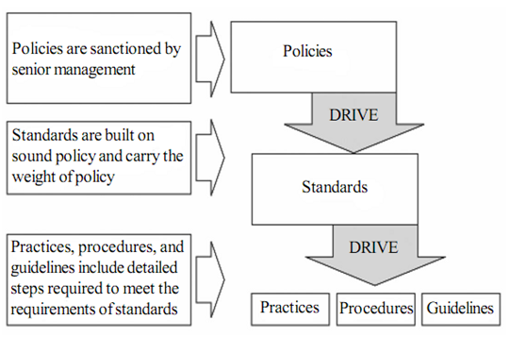
Contd..

Slide 46
Need of Security Policy
Protects organization through proactive policy stance.
Establishes the rules for user behavior and any other IT personnel.
Define and authorize consequences of violation.
Establish baseline stance on security to minimize risk for the organization.
Ensure proper compliance with regulations and legislation.

Slide 47
Security Policy benefits
Minimizes risk of data leak or loss.
Protects the organization from “malicious” external and internal users.
Sets guidelines, best practices of use, and ensures proper compliance.
Announces internally and externally that information is an asset, the property of the organization, and is to be protected from unauthorized access, modification, disclosure, and destruction.

Slide 48
Components of Security Policy
Governing Policy
Technical Policy
End-User Policy

Slide 49
Governing Policy
Discusses high level information security concepts.
Defines what these information security concepts are, their importance, and the organizational stance on these security concepts.
Read by management and end users.
Aligns with other company policies.
Supports the rest of the components of the security policy.

Slide 50
Technical policies
Covers some of the topics within the Governing Policy.
Technical policies are used for more specific technical topics.
Types of policies include:
Operating Systems
Application, Network, and
Mobile Devices.

Slide 51
End-User Policy
It conveys all important topics to the end user.
It answers security policy questions at the appropriate level.

Slide 52
Standards
A "standard" is a low-level prescription for the various ways the company will enforce the given policy.
Standard consists of low level mandatory controls, which help to support the information security policy.
It normally contains security controls related to specific technology
Standard improves the security of the system.
For example, "Passwords will be at least 8 characters, and require at least one number."

Slide 53
Guidelines
A piece of advice on how to act in a given situation
Recommended but Non Mandatory Control
Example: Employment Discrimination Guidelines, Screening Guideline
Extras: ‘Guide’ + ’Lines’ meaning Instructions for guiding purposes only

Slide 54
Guidelines
Guideline is a detailed plan or explanation to guide you in setting standards or determining course of action.
Guidelines are similar to standards but are more flexible and are not mandatory.
For example: Password must have 8 characters (Standards)
Whereas the password expires in 30 days (Guidelines)

Slide 55
Procedures
A series of detailed steps to accomplish an end
Step by step instructions for implementation
A "procedure" can describe a step-by-step method to implementing the policies, standards and guidelines.
For example : To change password , First enter the old password and then create the new password.

Slide 56
Monitoring and Diagnosing Network
Firewall

Slide 57
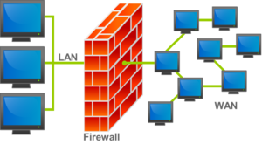
Firewall
Firewall Design Principles
Firewall Characteristics
Types of Firewalls
Firewall Configurations

Slide 58
Rules Determine
WHO ? WHEN ?
WHAT ? HOW ?
INTERNET
My PC
Secure
Private
Network
Firewall

Slide 59
Firewall
A firewall is a hardware or software designed to permit or deny network transmissions based upon a set of rules and is frequently used to protect networks from unauthorized access while permitting legitimate communications to pass.
It is hardware, software, or a combination of both.
Used to prevent unauthorized programs or Internet users from accessing a private network and/or a single computer.

Slide 60
Hardware vs. Software Firewalls
Hardware Firewalls
Protect an entire network
Implemented on the router level
Usually more expensive, harder to configure
Software Firewalls
Protect a single computer
Usually less expensive, easier to configure

Slide 61
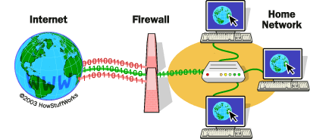
Software Firewall working Principle
Inspects each individual “packet” of data as it arrives at either side of the firewall
Determines whether it should be allowed to pass through or if it should be blocked

Slide 62
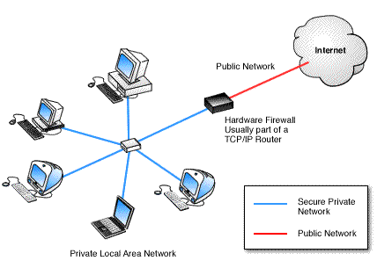
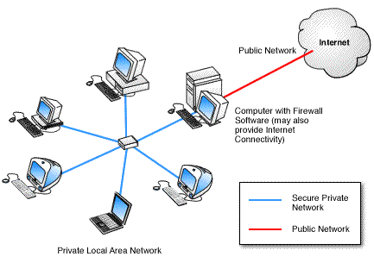
Hardware Vs Software

Slide 63
Firewall Rules
Allow – traffic that flows automatically because it has been deemed
Block – traffic that is blocked because it has been deemed dangerous to your computer
Ask – asks the user whether or not the traffic is allowed to pass through

Slide 64
What Can a Firewall Do?
Stop hackers from accessing your computer
Protects your personal information
Blocks “pop up” ads and certain cookies
Determines which programs can access the Internet

Slide 65
What Can't a Firewall Do?
Can't protect you against malicious insiders
Can't protect against completely new threats
Can't protect against viruses

Slide 66
Need of Firewall
Avoid:
Theft or disclosure of internal data
Unauthorized access to internal hosts
Interception or alteration of data
Vandalism & denial of service

Slide 67
Firewall Design Principle
Effective means of protection a local system or network of systems from network-based security threats while affording access to the outside world via WAN`s or the Internet.
The firewall is inserted between the premises network and the Internet
Aims:
Establish a controlled link
Protect the premises network from Internet-based attacks
Provide a single choke point

Slide 68
Firewall Characteristics
Design goals:
All traffic from inside to outside must pass through the firewall (physically blocking all access to the local network except via the firewall)
Only authorized traffic (defined by the local security police) will be allowed to pass.
The firewall itself is immune to penetration (use of trusted system with a secure operating system)

Slide 69
Types of Firewalls
Three common types of Firewalls:
Proxy or Packet-filtering routers
Proxy or Application-level gateways
Circuit-level gateways
Bastion host

Slide 70
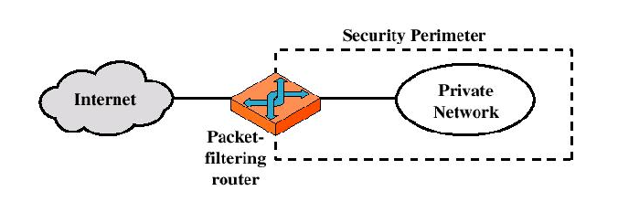
Packet Filtering Routers

Slide 71
Packet-filtering Router
Applies a set of rules to each incoming IP packet and then forwards or discards the packet
Filter packets going in both directions.
The packet filter is typically set up as a list of rules based on matches to fields in the IP or TCP header.
Two default policies (discard or forward)

Slide 72
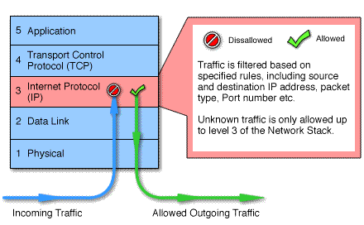
Packet Filtering

Slide 73
Pros and Cons
Advantages:
Simplicity
Transparency to users
High speed
Disadvantages:
Difficulty of setting up packet filter rules
Lack of Authentication

Slide 74
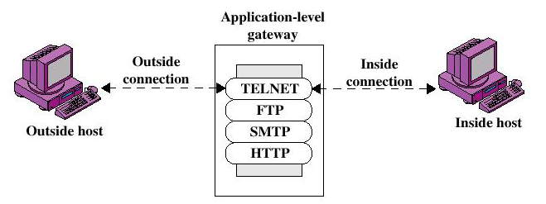
Application Level Gateway
Gateway sits between user on inside and server on outside. Instead of talking directly, user and server talk through proxy.
For example, ftp server may not allow files greater than a set size.
A mail server is an example of an application gateway
Can’t deposit mail in recipient’s mail server without passing through sender’s mail server

Slide 75
Application Level gateway
Application-level Gateway
Also called proxy server
Acts as a relay of application-level traffic
Advantages:
Higher security than packet filters
Only need to scrutinize a few allowable applications
Easy to log and audit all incoming traffic
Disadvantages:
Additional processing overhead on each connection.

Slide 76
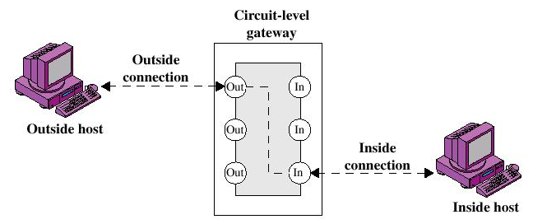
Circuit Level Gateway

Slide 77
Circuit Level Gateway
Circuit-level Gateway
Stand-alone system or
Specialized function performed by an Application-level Gateway
Sets up two TCP connections
The gateway typically relays TCP segments from one connection to the other without examining the contents

Slide 78
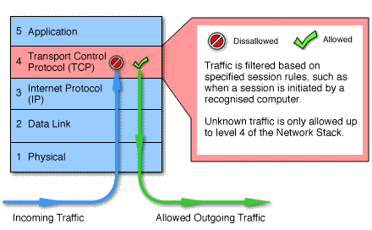
Circuit Level Gateway
The security function consists of determining which connections will be allowed
Typically use is a situation in which the system administrator trusts the internal users
An example is the SOCKS package

Slide 79
Bastion Host
A bastion host is a special purpose computer on a network specifically designed and configured to withstand attacks.
A system identified by the firewall administrator as a critical strong point in the network´s security.
The bastion host serves as a platform for an application-level or circuit-level gateway
Highly secure host system

Slide 80
Bastion Host
Potentially exposed to "hostile or dislike" elements
Hence is secured to withstand this
Disable all non-required services; keep it simple
Trusted to enforce trusted separation between network connections
Runs circuit / application level gateways
Install/modify services you want
Or provides externally accessible services

Slide 81
Firewall Configurations
In addition to the use of simple configuration of a single system (single packet filtering router or single gateway), more complex configurations are possible
Three common configurations
Screened host firewall system (single-homed bastion host)
Screened host firewall system (dual-homed bastion host)
Screened-subnet firewall system

Slide 82
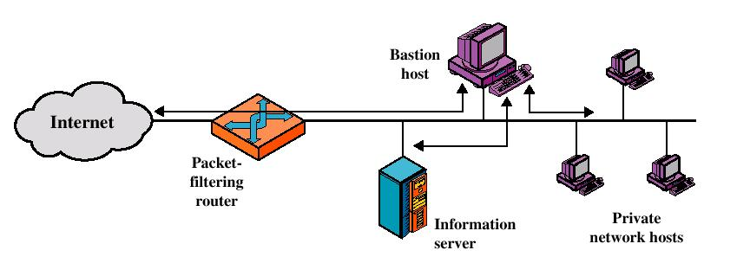
Screened host firewall system (single-homed bastion host)

Slide 83
Firewall Configuration
Screened subnet firewall configuration
Most secure configuration of the three
Two packet-filtering routers are used
Creation of an isolated sub-network

Slide 84
Firewall Configuration
Advantages:
Three levels of defense to thwart intruders
The outside router advertises only the existence of the screened subnet to the Internet (internal network is invisible to the Internet)
The inside router advertises only the existence of the screened subnet to the internal network (the systems on the inside network cannot construct direct routes to the Internet)

Slide 85
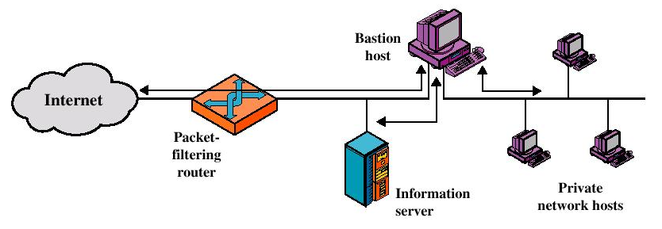
Screened host firewall system (dual-homed bastion host)

Slide 86
Firewall Configuration
Screened host firewall, dual-homed bastion configuration
The packet-filtering router is not completely compromised
Traffic between the Internet and other hosts on the private network has to flow through the bastion host

Slide 87
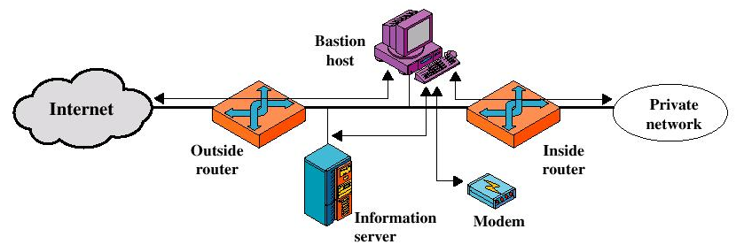
Screened-subnet firewall system

Slide 88
Monitoring and Diagnosing Network
Intrusion Detection Systems

Slide 89
Intrusion
Intrusion : Attempting to break into or misuse your system or the activities that violate the security policy of system.
Intruders may be from outside the network or legitimate users of the network.
Intrusion Detection System (IDS) : is software that automates the intrusion detection process. The primary responsibility of an IDS is to detect unwanted activities.
Intrusion Prevention System (IPS) : is software that has all the capabilities of an intrusion detection system and can also attempt to stop possible incidents.

Slide 90
Classes of Intruder
Three classes of intruders:
Masqueraders: An individual who is not authorized to use the computer and who penetrates a system’s access controls to exploit a legitimate user’s account.
Misfeasor: A legitimate user who accesses data, programs or resources for which such access is not authorized, or who is authorized for such access but misuses his or her privileges.
Clandestine user: An individual who seizes supervisory control of the system and uses this control to evade auditing and access controls or to suppress audit actions.

Slide 91
Classes of Intruder
Three classes of intruders:
Masqueraders: An individual who is not authorized to use the computer and who penetrates a system’s access controls to exploit a legitimate user’s account.
Misfeasor: A legitimate user who accesses data, programs or resources for which such access is not authorized, or who is authorized for such access but misuses his or her privileges.
Clandestine user: An individual who seizes supervisory control of the system and uses this control to evade auditing and access controls or to suppress audit actions.

Slide 92
Methods of Intrusions
The methods used by intruders can often contain any one, or even combinations, of the following intrusion types:
Distributed Denial of Service
Trojan Horse
Viruses and Worms
Spoofing
Network/Port Scans
Buffer Overflow

Slide 93
An effective IDS should be able to
Run continually with minimal human supervision
Withstand an attack and continue functioning
Monitor itself and resist local intrusion
Use minimal resources
Adapt and recognize "normal" behavior

Slide 94
Intrusion Detection Systems (IDS)
Intrusion detection is the process of identifying and responding to malicious activity targeted at resources.
IDS is a system designed to test/analyze network system traffic/events against a given set of parameters and alert/capture data when these thresholds are met.
IDS uses collected information and predefined knowledge-based system to reason about the possibility of an intrusion.
IDS also provides services to cop with intrusion such as giving alarms, activating programs to try to deal with intrusion, etc.

Slide 95
Intrusion Detection Systems (IDS)
Based on the sources of the audit information used by each IDS, the IDSs may be classified into
Different ways of classifying an IDS
IDS based on
Anomaly detection
Signature based misuse
Host based
Network based
Stack based

Slide 96
Anomaly based IDS
This IDS models the normal usage of the network as a noise characterization.
Anything distinct from the noise is assumed to be an intrusion activity.
E.g. flooding a host with lots of packet.
The primary strength is its ability to recognize novel attacks.

Slide 97
Statistical Anomaly Detection
Statistical anomaly detection involves the collection of data relating to the behavior of legitimate users over a period of time.
Then statistical tests are applied to observed behavior to determine with a high level of confidence whether that behavior is not legitimate user behavior.
Statistical anomaly detection falls into two broad categories:
Threshold detection.
Profile based anomaly detection.

Slide 98
Statistical Anomaly Detection
Threshold detection involves counting the numbers of occurrences of specified event type over an interval of time
Profile-based anomaly detection focuses on characterizing the past behavior of individuals users or related groups of users and then detecting significant deviations
Examples of parameters that are useful for profile-based intrusion detection are the following:
Counter and Interval timer.

Slide 99
Statistical Anomaly Detection
Counter: Typically, a count of certain event types is kept over a particular period of time.
Examples include the numbers of logins, number of password failures, number of times a given command is executed during a single user session.
Interval timer: The length of time between two related events.
Ex. is the length of time lapsed between two successive logins to an account.

Slide 100
Statistical Anomaly Detection
Counter: Typically, a count of certain event types is kept over a particular period of time.
Examples include the numbers of logins, number of password failures, number of times a given command is executed during a single user session.
Interval timer: The length of time between two related events.
Ex. is the length of time lapsed between two successive logins to an account.

Slide 101
Drawbacks of Anomaly detection IDS
Assumes that intrusions will be accompanied by manifestations that are sufficiently unusual so as to permit detection.
These generate many false alarms and hence compromise the effectiveness of the IDS.

Slide 102
Signature based IDS
This IDS possess an attacked description that can be matched to sensed attack manifestations.
The question of what information is relevant to an IDS depends upon what it is trying to detect.
E.g. DNS, FTP etc.
ID system is programmed to interpret a certain series of packets, or a certain piece of data contained in those packets, as an attack.
For example, an IDS that watches web servers might be programmed to look for the string “phf” as an indicator of a CGI program attack.

Slide 103
Signature Based IDS
Signature Detection to discriminate between anomaly or attack patterns (signatures) and known intrusion detection signatures.
It is a technique often used in the Intrusion Detection System (IDS) and many anti-mal ware systems such as anti-virus and anti-spyware etc.
In the signature detection process, network or system information is scanned against a known attack or malware signature database.
If match found, an alert takes place for further actions.

Slide 104
Signature based IDS (contd.)
Most signature analysis systems are based off of simple pattern matching algorithms.
In most cases, the IDS simply looks for a sub string within a stream of data carried by network packets.
When it finds this sub string (for example, the ``phf'' in ``GET /cgi-bin/phf?''), it identifies those network packets as vehicles of an attack.

Slide 105
Drawbacks of Signature based IDS
They are unable to detect novel attacks.
Suffer from false alarms.
Have to programmed again for every new pattern to be detected.

Slide 106
Host/Applications based IDS
Host-based Intrusion Detection Systems are confined to monitoring activity on the local host computer.
This monitoring can include network traffic to the host, or local object (files, processes, services) access on the host.
The host operating system or the application logs in the audit information.
These audit information includes events like the use of identification and authentication mechanisms (logins etc.) , file opens and program executions, admin activities etc.
This audit is then analyzed to detect trails of intrusion.

Slide 107
Strengths of the host based IDS
Attack verification
System specific activity
Encrypted and switch environments
Monitoring key components
Near Real-Time detection and response.
No additional hardware

Slide 108
Future of IDS
To integrate the network and host based IDS for better detection.
Developing IDS schemes for detecting novel attacks rather than individual instantiations.

Slide 109
Intrusion Prevention System
Intrusion prevention systems are network security devices that monitor network and/or system activities for malicious activity (intrusion)
Main functions of Intrusion Prevention System (IPS) are:
– Identify intrusion
– Log information about intrusion
– Attempt to block/stop intrusion and
– Report intrusion
Intrusion Detection System (IDS) only detect intrusions

Slide 110
IPS
Intrusion Prevention System (IPS) is any device (hardware or software) that has the ability to detect attacks, both known and unknown, and prevent the attack from being successful.
The bad guys are always one step ahead of the security professionals.
Security professionals try and come up with innovative means to detect and prevent attacks.
IPS is a preventive device rather than a detective device (IDS).

Slide 111
CLASSIFICATION OF IPS
Broadly classified into two categories
Host IPS (HIPS)
Network IPS (NIPS)

Slide 112
HOST Based-IPS
HIPS is installed directly on the system being protected
It binds closely with the operating system kernel and services, it monitors and intercepts system calls to the kernel in order to prevent attacks as well as log them.

Slide 113
NETWORK Based-IPS
Has two network interfaces, one designated as internal and one as external.
Packets passed through both interfaces and they determined whether the packet being examined poses a threat.
If it detects a malicious packet, an alert is raised, the packets are discarded immediately. Legitimate packets are passed through to the second interface and on to their intended destination.

Slide 114
INTRUSION PREVENTION TECHNIQUES..
Inline network intrusion protection systems.
Layer seven switches.
Application firewalls.
Hybrid switches.
Deceptive applications.

Slide 115
INLINE NETWORK IPS
It is configured with two NICs, one for management and one for detection.
NIC that is configured for detection usually does not have an IP address assigned .
It works by sitting between the systems that need to be protected and the rest of the network.
It inspects the packet for any intrusion that it is configured to look for.

Slide 116
LAYER SEVEN SWITCHES
Placing these devices in front of your firewalls would give protection for the entire network.
However the drawbacks are that they can only stop attacks that they know about.
The only attack they can stop that most others IPS can’t are the DoS attacks.

Slide 117
APPLICATION FIREWALLS
These IPSs are loaded on each server that is to be protected.
These types of IPSs are customizable to each application that they are to protect.
It profiles a system before protecting it. During the profiling it watches the user’s interaction with the application and the applications interaction with the operating system to determine what legitimate interaction looks like.
The drawback is that when the application is updated it might have to be profiled again so that it does not block legitimate use.

Slide 118
HYBRID SWITCHES
They inspect specific traffic for malicious content as has been configured .
Hybrid switch works in similar manner to layer seven switch, but has detailed knowledge of the web server and the application that sits on top of the web server.
It also fails, if the user’s request does not match any of the permitted requests.

Slide 119
Honey Pots, Honey Nets, and Padded Cell Systems
Powerful security tools that go beyond intrusion detection
Honey Pots or Honey Pot Systems
Decoy systems designed to lure potential attackers away from critical systems and encourage attacks against the decoy
Designed to divert attackers from critical systems, collect information about their activity, and encourage attackers to stay on the system long enough to be documented.

Slide 120
Cont…
Honey Net
A collection of several honey pot systems on one subnet.
Contains pseudo-devices configured in ways to make it look vulnerable.
Padded Cell
A honey pot that has been protected so it cannot be easily compromised --- a hardened honey pot.
When IDS detects attackers, it transfers them to a specialized environment where they can do no harm.
Use of these techniques may be construed as illegal.

Slide 121
Pros & Cons of Honey Pot Systems
Pros
Attackers diverted to targets where they can do no damage
Allows time to decide how to respond to an attacker
Attacks can be monitored to obtain useful information that can be used to develop better defensive methods
May be effective for identifying insiders who are snooping around the network
Cons
Legal implications not well defined
Not yet shown to be generally useful technologies
May provoke expert hackers to more hostile attacks
High level of expertise required to use these types of systems

Slide 122
THANK YOU

